Slide 1
An Investigation into the Convergence of
Ant Colony Optimisation Systems
Elmo Barratt

Slide 2
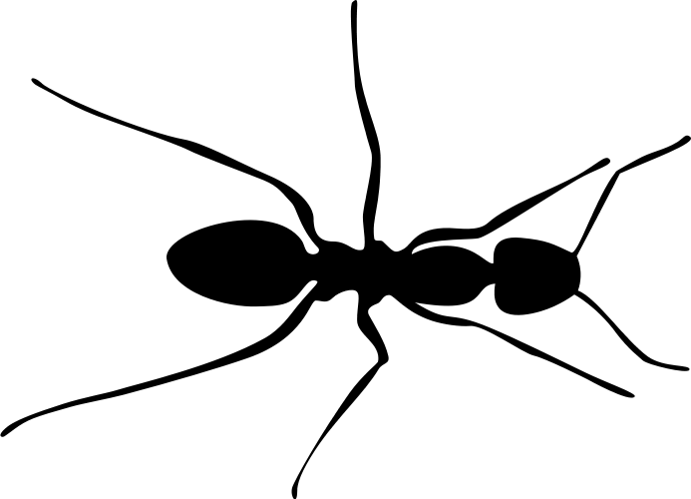
Foraging Behaviour of Ants
A
Food
Source
Ant
Colony
B
Notes:
Here we have the so called double bridge experiment.
Ants emerge from the colony and get to vertex here. They then have the choice whether to traverse arc A or B. These ants are simple agents and do not have foresight to predict which path is better, so initially, the ant will choice either arc with uniform probability.
It then gathers food and return to the nest.

Slide 3
Foraging Behaviour of Ants
A
Food
Source
Ant
Colony
B
Notes:
Another foraging ant may choose path B but no ant can determine the optimal strategy independently.

Slide 4
Foraging Behaviour of Ants
A
Food
Source
Ant
Colony
B
Notes:
One crucial mechanic in their behaviour is the use of pheromones. As each ant walked the paths A and B, they deposited a trail pheromone which acts as an attractive signal to other ants in the colony. These pheromones evaporate and as they do become weaker. Since arc B is longer than A, it takes longer for an ant to traverse it and therefore there is more time for pheromone evaporation to take place before any other ant senses them. We therefore see a higher pheromone concentration on the shorter arc length A.
The short paths by the colony and food source are both high in pheromone concentration as the ants are forced to walk here.

Slide 5
Foraging Behaviour of Ants
A
Food
Source
Ant
Colony
B
Notes:
Now as another ant leaves the colony it reaches the split in the path, whereas before it would have taken a uniformly random decision as to which path to take, it now favours the trail with higher pheromone concentration and will choose A with a higher probability than B.

Slide 6
Foraging Behaviour of Ants
A
Food
Source
Ant
Colony
B
Notes:
As a result the pheromone concentration along trail A increases again in a positive feedback loop leading to an optimized time-reasource allocation strategy for the colony.
This self organizing behaviour is an example of swarm intelligence, where each individual agent adheres to simple rules absent from critical thinking yet as a colony, intelligent and complex behaviour can emerge.

Slide 7
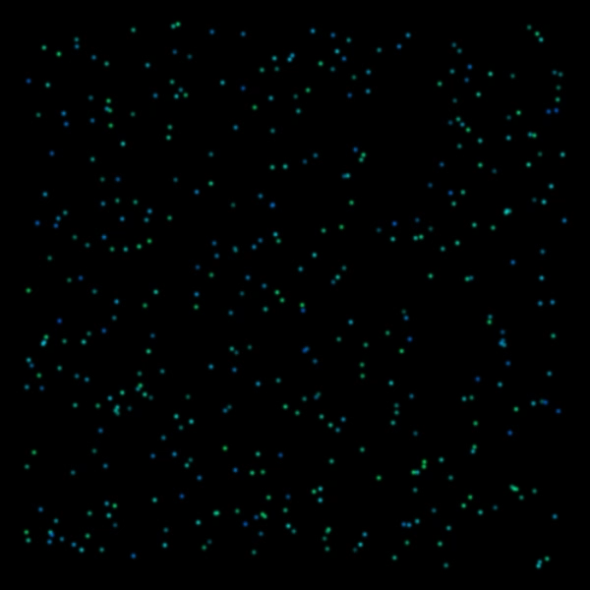
Organic Simulation
Notes:
The double bridge experiment is perhaps the simplest setup to demonstrate the mechanic at play but just to give a nicer visual understanding I want to show you a continuous time, continuous space simulation where 400 agents are randomly positioned and given an initial random direction. The perform a random walk where at each frame of the animation they choose a random angle to adjust their direction by and then take a step forward. This angle is chosen proportional to the brightness of the pixels in front of them where brighter pixels correspond to higher pheromone concentration. As each agent walks, it itself leaves a trail of pheromones behind it. Pheromones evaporate away in each frame as well. Watch as the fascinatingly organic behaviour emerges out of these simple rules.
This gives a really nice visual intuition for the mechanic at play, but what is the point of all this ? How can we mathematically formalize such phenomenon and use it as a tool for problem solving.

Slide 8
Definition (Combinatorial Optimisation Problem)
Notes:
Here I introduce the type of problem I aim to solve using Ant colony optimisation.
A combinatorial optimisation problem is defined as the following triple. A set of constraints to the problem, the feasible solution space which is a subset of the solution space once the set of constraints its imposed upon it, and a cost objective function which maps from the feasible solution space to the real numbers. We aim to minimize this cost function and find the element of the solution space that maps to the minimum as our solution to the COP.

Slide 9
Example (Travelling Salesman Problem)
Notes:
The travelling salesman problem (T.S.P) is a classical problem in combinatorics formulated in the 19th century by W.R. Hamilton and goes as such;
Given a list of cities and the distances between each pair of cities, what is the shortest possible route that visits each city exactly once returning to the initial city at the end?
We can write this problem as a combinatorial optimisation problem where:
K_n=(V,E) is the complete directed graph on n vertices where each city corresponds to a vertex and the edge weight $e_{i,j} = d(i,j)$ the distance between city i and city j.
W is set of length n+1 sequences on the first n integers such that the first and last element are the same and all others are unique thus ensuring each vertex is visited exactly once with exception of start and end node which are the same. Elements of this set W can be referred to as closed Hamiltonian paths on K_n.
Cost objective function f is defined as the sum of edge weights along the path w, therefore giving the total distance traversed. We aim to find the optimal cycle given by w^* where w^* is as the solution at which function f achieved its global minimum.

Slide 10
Example (Travelling Salesman Problem)
Notes:
In order to empirically determine what the optimal solution to the TSP is for a specified set of edge weights is, we would need to calculate the cost of every closed Hamiltonian path. The number of unique Hamiltonian closed paths on K_n up to repetitions due to shifts and reflections is given by this quantity where we derive this from the fact there are n! permutations of vertices 1 to n. There is a shift symmetry of these permutations corresponding to the n possible starting nodes leading us to divide by n, we further have to divide by 2 to take account for the reflections of permutations. We then use stirlings approximation.
The consequence of this result is that as n increases, the number of unique Hamiltonian closed paths in K_n grows asymptotically faster than any polynomial and even any exponential in n, making an exhaustive search of the solution space infeasible.
It has actually been shown that the TSP belongs to a class of problems labelled NP Hard, meaning that it takes as least as much time as any nondeterministic polynomial to solve.
Here We introduce the idea of a heuristic algorithm where instead of minimizing the cost objective function over the solution space as you would in an exhaustive search, we use probability to search only a fraction of the solution space trading off accuracy for reduced computation load / time.

Slide 11
Virtual Agents solving the TSP – Parameters and Variables
Notes:
Taking inspiration from the foraging behaviour and self organisation of ants, we can build an algorithm to tackle the TSP.
In order to explain this algorithm we must first detail the key parameters and variables involved.
We index the algorithm by cycle number m, this starts at 1 and then increases by 1 each time a cycle is complete.
In any given cycle m, all the S agents from the colony identically and independently of one another sample a solution from feasible solution space according to the probability distribution mu_m, more on how this pdf is determined in a minute.
Introducing the cycle-m pheromone concentration matrix. Each entry tau_ij corresponds to the pheromone concentration along directed edge (i,j) of the complete graph and all entries sum to 1 as a normalizing condition for simplicity. we create a change in pheromone matrix Delta tau. Each solution w contains n edges, for each edge (I,j) we add the reciprocal of the cost of solution w to the change in pheromone matrix. This means lower costs will contribute greater pheromone concentration to the matrix delta tau. We then normalize delta tau so all entries sum to 1 and calculate tau(m) the phermone concentration matrix in the mth cycle by taking a convex combination of delta tau and tau(m-1). Since both matrices are normalised, the resulting convex combination will also be.
The pheromone evaporation constant rho is the constant used when taking this convex combination as seen by the rule above. This gives the intuition that a smaller evaporation constant would result in smaller influence from the sampled solutions in cycle m and more influence from the state that the pheromone concentration matrix was in before.

Slide 12
Virtual Agents solving the TSP – Transition Probabilities
Notes:
Having now calculated the pheromone concentration matrix in cycle m, this cycle is essentially complete. The last thing to mention is the way we determine the m^th cycle probability measure. We use the pheromone concentration matrix and edge weights of the graph from cycle m-1 to find transition probabilities using the above formula. Alpha and beta are the weighting parameters controlling the relative influence of pheromone values and edge weights on transition probabilities for the agents.
To find the probability of some solution w being sampled by an agent, we simply multiply along the transition probabilities noting that these are not markovian as the probability of moved from state i to j depends on information about where it has been before as an agent may not visit a node twice unless upon finally return to the starting node.
This formula shows that edges with higher pheromone concentration or edges with smaller edge weight will give a higher transition probability where the former case mirrors the biological analogue.

Slide 13
Ant Colony Algorithm Convergence Results
Notes:
One of the first theoretical results derived about ACOs was by Gutjar in 2000 and had the central theorem given above. This essentially says we can bound the probability that from some cycle, m0, some agent will sample the optimal path in every subsequent cycle, arbitrarily close to 1. Whatsmore, this result can be achieved in 2 different ways.
We can do this by increasing the number of agents in the colony S to be sufficiently large so in each cycle, a greater part of the solution space is likely to be explored.
Or we can make the pheromone evaporation constant sufficiently close to 0, this means that pheromone trails will take more time to strengthen leaving opportunity for agents to explore a greater variety of solutions before becoming settled one one.
We can distinguish two types of heuristic algorithm, optimization-capable and non-optimizing, this ACO being the former, meaning there is no principle obstacle preventing us from getting closer and closer to the true optimum, providing enough computational power is invested and the latter describing a case where the produced solution quality may always be at a certain distance from the optimum.
Whilst academically insightful, this result has limitations. In the proof of this theorem, the most coarse bounds are used at almost every step, using estimates for the ‘worst case scenario’. This often means that to use bounds derived in the proof of the theorem often defeats the purpose of a heuristic approach as more computational power must be invested than that of an exhaustive search of the solution space.

Slide 14
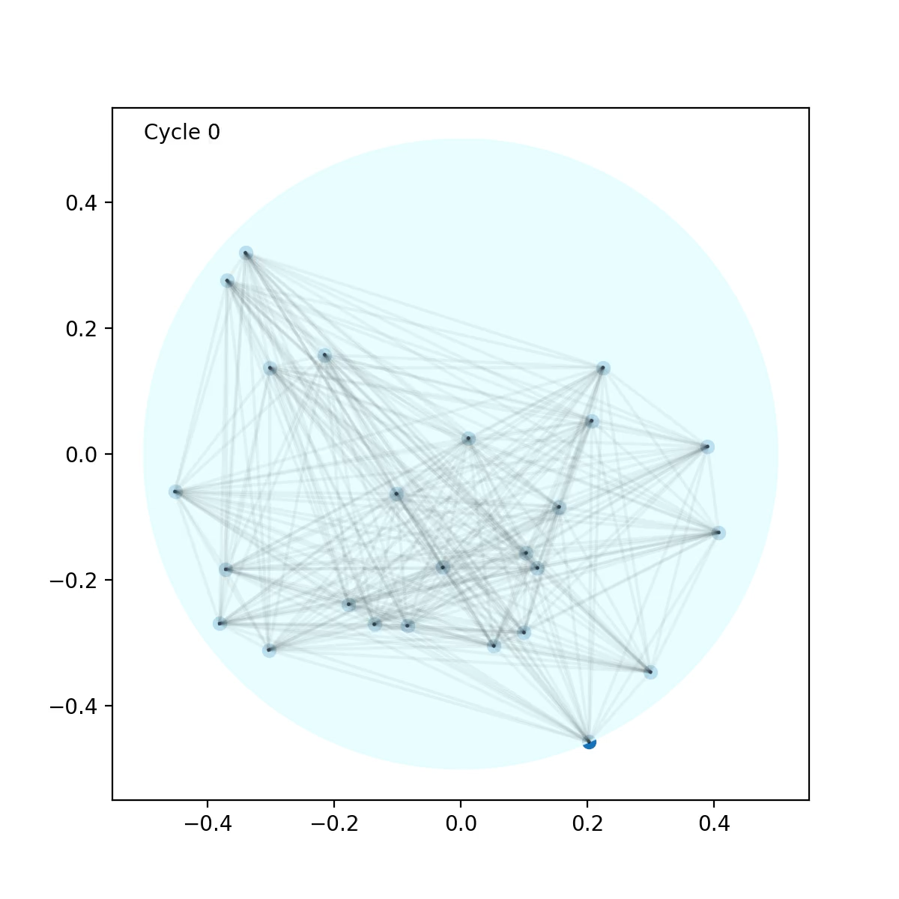
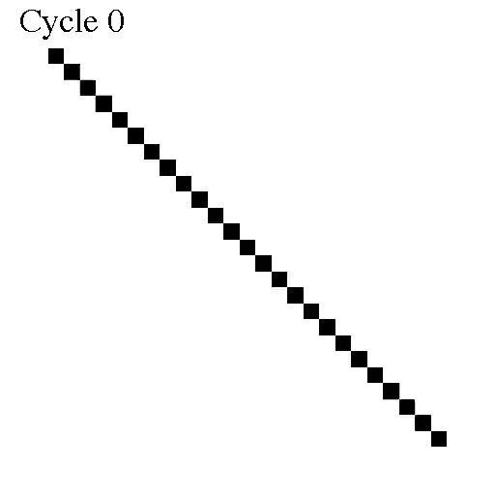
Notes:
At this point in my investigation I decided that I would break away from theoretical results and see what I could produce in practical simulations. I decided I would sample n points from the unit disk and join them up to become the complete graph with edge weights equal to the Euclidean distance between them.
On the left is a visual representation of the TSP being solved through the ACO algorithm where the strength of opacity of edges corresponds to the strength of pheromone trails along that edge. Initially all edges have

